Slide 1




Reproducing and Replicating Spatial Data Science
Joseph Holler, Peter Kedron, and Sarah Bardin
HEGSRR.github.io
Funding Support from NSF BCS-2049837, NSF OAC-1743184

Slide 2
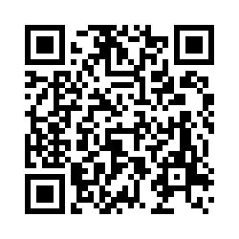
Tell us what you think
Please take 2mins to complete a short survey about open science research practices
go.middlebury.edu/hegsrr
Protocol
Sort 11 open and reproducible research practices (ORRP)
Already using
Aware and interested in using
Unaware or uninterested
10 likert technology adoption questions
Share deidentified data
Follow-up surveys (immediate, one year)

Slide 3
Defining Reproducibility and Replicability
A brief definition for spatial data science

Slide 4
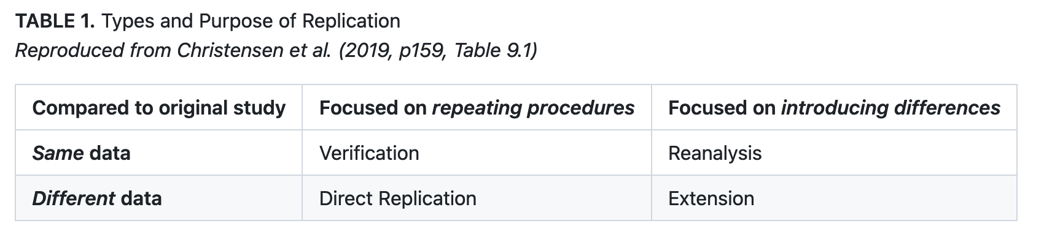
Reproduction and Replication
(Schmidt 2009, Gomez et al. 2010, Barba 2017, Christensen et al. 2019, NASEM 2019)

Slide 5
Reproduction and Replication
(Schmidt 2009, Gomez et al. 2010, Barba 2017, Christensen et al. 2019, NASEM 2019)
Reproduction
Same data, same procedure, same results, same context

Slide 6
Reproduction and Replication
(Schmidt 2009, Gomez et al. 2010, Barba 2017, Christensen et al. 2019, NASEM 2019)
Reproduction
Same data, same procedure, same results, same context
Replication
New data, similar procedure, similar results, same or new context

Slide 7
Veridical Spatial Data Science
Munafo et al. (2016), Kedron et al. (2020), Yu & Kumbier (2020)
Principled inquiry to extract reliable and reproducible information from spatialtemporal data, with an enriched technical language to communicate and evaluate empirical evidence in the context of human decisions, domain knowledge, and geographic confounds; supported by a system of external validation and evidence accumulation based on the purposeful replication of findings across space and time.
(Adapted from Kedron and Bardin 2021, Yu and Kumbier 2020)

Slide 8
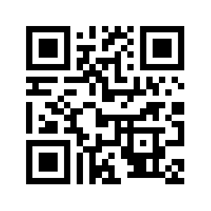
Our R&R Related Resources
Munafo et al. (2016), Kedron et al. (2020), Yu & Kumbier (2020)
hegsrr.github.io
5 Peer-reviewed Publications
8 Reproduction and Replication Studies
2 Surveys of Researcher Practices
Reproducible Project Repository Template
Manual In Development
2 Course Syllabi
9 RAs Mentored
~50 Students Engaged in R&R Studies
hegsrr.github.io/Workshop-SDSS-2023/

Slide 9
Survey Results
The reproducible research practices you identified as interesting and important
Link to Report

